Slide 1

Lesson Tool 2: Human issues in HCI
After studying this lesson tool, you should:
• understand how perception and cognition influence user interface design
• understand the differences between short- and long-term memory and their influence on interface design
• know how the physical attributes of users can affect their interaction with computers
• understand how users may differ in terms of culture, personality, gender and age, and how these differences impact on HCI
• understand how different levels of expertise influence users’ interaction with a system
• know the kinds of errors humans make, why they make them, and how this should be addressed in user interface design

Slide 2
In this lesson tool, we focus on the “human” in human-computer interaction.
What must be considered when developing and installing computer systems?
Cognitive Psychology in HCI
Many cognitive processes underlie the performance of a task or action performed by humans. Human information processing consists of three interacting systems: the perceptual system, the cognitive system, and the motor system.
We can characterise human (user) resources into three categories:
  Perception: the way that people detect information in their environment.
  Cognition: the way that they process that information.
  Physiology: the way in which they move and interact with physical objects in their environment.
1.Perception
The use of senses to detect information
▪ The way that people detect information in their environment
▪ Human ability to interpret sensory input rapidly and initiate complex actions makes the use of modern computer systems possible
▪ If a person doesn’t act on sensory input immediately, it will not have any effect.
Shneiderman identified a number of design implications for the design of information to be perceptible and recognisable across different media:
  Distinguishable icons and graphical representations
  Effective use of borders and spacing to group & locate information easier
  Audible and distinguishable sounds
  Understandable & distinguishable speech output
  Legible & distinguishable text
  Tactile feedback in a virtual environment should allow users to recognise meanings of touch sensations being emulated e.g squeezing vs pushing.

Slide 3
Factors affecting perception
  Change in output such as loudness /display size
  Maximum & minimum detectable levels, e.g. sound
  Field of perception –depends on the environment (can the user see the display?)
  Fatigue / Circadian(biological) rhythms – tiredness -> slower
  Background noise
Partial sight, ageing and congenital colour defects produce changes in perception that reduce the visual effectiveness of certain colour combinations.
People with colour perception defects generally see less contrast between colours than someone with normal vision.
Three aspects of colour influence how they are perceived:
Colour hue ▪ Perceptual attributes associated with elementary colour names ▪ Enables us to identify basic colours ▪ Variety, tint, or quality of a colour.
Colour lightness ▪ How much light is reflected from a surface in relation to nearby surfaces. ▪ Most important attribute in making contrast more effective.
Colour saturation ▪ The degree of intensity of a colour. ▪ Associated with a colour’s perceptual difference from a white, black or grey of equal lightness.
2. Cognition
▪ The way that information detected is processed
▪ These processes include:
  ▪ Short-term memory and information processing
  ▪ Long-term memory and learning
  ▪ Problem-solving
  ▪ Decision-making
  ▪ Attention
  ▪ Search and scanning
  ▪ Time perception
Attention
It’s a process of concentrating on something (object, task or conversation) at a specific point in time.
Involves our senses such as looking at the road while driving or listening to a news story on the radio, or it can involve thinking processes such as concentrating on solving a mathematical problem
Allows us to focus on information which is relevant to what we are doing
Influenced by the way information’s presented as well as by people’s goals

Slide 4
Shneiderman’s guidelines for designers to get the user’s attention
Intensity: use of two levels only with limited use of high intensity to draw attention.
Marking:
  Underline, enclose in a box, point at it with an arrow, or make use of an indicator such as an asterisk, bullet, plus sign or an X.
Size: Use only four sizes; the larger sizes attracting attention.
Choice of fonts: Not more than three sizes
Inverse video. Use inverse (reverse) colouring
Blinking. Use blinking display (2-4 Hz) or blinking colour changes
Colour: Use only four standard colours, reserve additional colours
Audio (alarms or voice messages to get attention)
  Soft tones for regular positive feedback
  Harsh sounds for rate emergency conditions
Memory –Consist of a number of systems that can be distinguished in terms of their cognitive structures as well as their perspective roles in the cognitive process.
STM – Short Term Memory
▪ Store information or events from the immediate past
▪ Retrieval is measured in seconds or sometimes minutes
▪ Relatively low capacity, fast access, and a short retention period
▪ “Working memory” - temporary memory to perform our everyday activities
▪ Effectiveness influenced by attention - distractions cause information to vanish
▪ Support STM by representing additional information on the display
▪ Seven-item boundary / limit
▪ Additional information can be held:
o Chunking involves grouping information into meaningful sections E.g. Telephone No’s 012 429 6122, Separator lines in menus
▪ Aim for user interface design is to reduce the load on short-term memory
▪ We can do this by recording information ‘in the world’ not ‘in the head’.

Slide 5
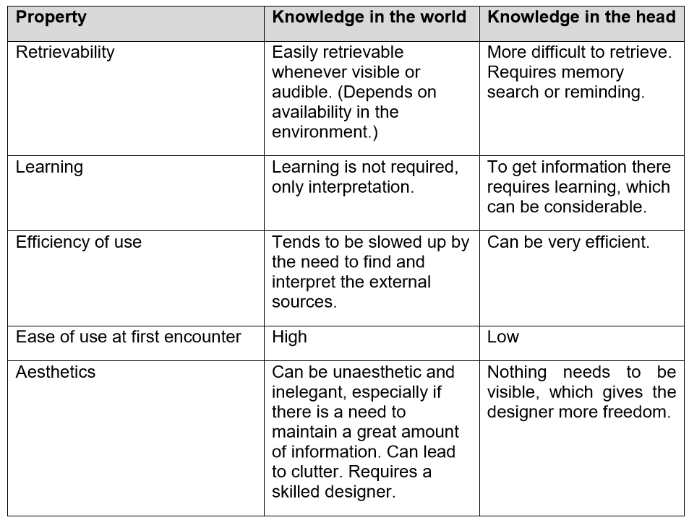
LTM - Long-Term Memory
▪ Holds information about events that happened hours, days, months or years ago and the information is usually incomplete.
▪ High capacity, slower access, and a long retention period.
▪ Affected by
  o People’s interpretation of the events or context.
  o The retriever’s current context or state of mind
▪ Storage and retrieval are easier when the material makes sense.
Knowledge in the World vs Knowledge in the Head
Norman (1999) refers to information kept in someone’s memory as “knowledge in the head” and to external information as “knowledge in the world”.
Some people rely more on knowledge in the world (eg notes, lists and birthday calendars) whereas others depend more on the knowledge in their heads (their memory). There are advantages and disadvantages to both approaches.
Comparison of knowledge in the head and in the world (from Norman (1999))

Slide 6
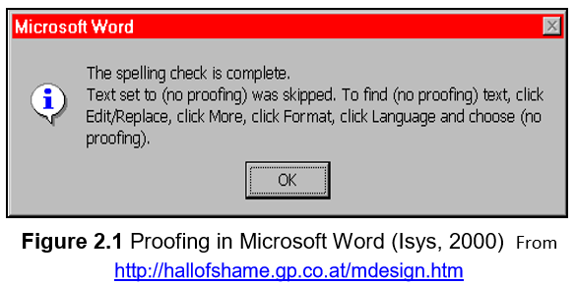
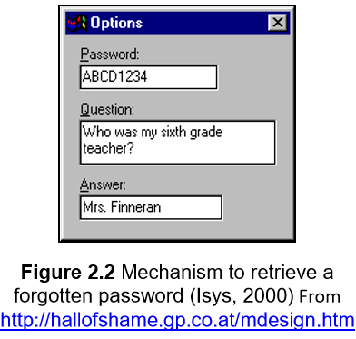
Examples to illustrate role of memory in HCI
3. Physiology - Physiology involves the study of the human anatomy.
Guidelines:
Physical Interaction and the Environment
Visual display should be positioned with the correct visual angle to the user.
• Keyboard and mouse use
  Prolonged periods of data entry place heavy stress upon the wrist and upper arm o Wrist supports, take frequent breaks
• Chairs and office furniture
  Well-designed chairs provide proper lower back support and promote a good posture in front of a computer.
• Placement of work materials:
  Users must be able to operate their system in conjunction with other sources of information and documentation.
• Other people
  Cannot rely on system operators to prevent bad things from happening.
  Unexpected events in environment can create potential disaster. Possible
The message is certainly informative but requires that the user either has an exceptional short-term memory or has pen and paper handy to write down the steps that it refers to.
When creating a new account, you are asked to specify the new password and, in addition, provide a question and answer in the event that you forget your password at some later time.

Slide 7
Possible sources of distraction in the working environment:
•Noise: Distraction can be caused by the sounds of other workers (phone calls, sound from their computers) and office equipment (fans, printers).
•Light: Bright lighting can cause distraction in interaction with computers
Urban myths (untruths) about the impact of computer systems on human physiology:
•Eyesight: Computer use does not damage your eyes or eyesight. It may, however, make you aware of existing defects.
•Epilepsy: Computer use does not appear to induce epileptic attacks. o Television may trigger photosensitive epilepsy but the visual display units of computers do not seem to have the same effect. o The effect of multimedia video systems upon this illness is still unclear.
•Radiation: The National Radiological Protection Board in the UK states that VDU’s do not ‘significantly’ increase the risk of radiation-related illnesses.
Users with Disabilities
Accessibility = degree to which an interactive product is usable by people with disabilities
Reasons for designing systems that is accessible to people with disabilities:
• Compliance with regulatory and legal requirements
• Exposure to more people
• Better design and implementation - enhances usability for all users
• Cost savings
Accessibility Guidelines
• Text alternatives
  To provide any non-text content so that it can be changed into other forms which users need
  E.g. into large print, Braille, speech, symbols, or simpler language.
• Time-based media
  If non-text content is time-based media, text alternatives:
1. Provides descriptive identification of the non-text content (eg, movies or animations) and,
2. Synchronises equivalent alternatives such as caption or auditory descriptions of the visual track with the presentation.

Slide 8
Distinguishable
  This guideline makes it easier for users to see and hear content and separates the foreground from the background.
  Colour is not used as the only visual means for conveying information, indicating an action, prompting a response, or distinguishing a visual element.
Predictable
  Web pages appear and operate in predictable ways
Users with Vision Impairments
Experience difficulties with output display besides the problems that the mouse and other input devices pose.
Solutions:
  Text-to-speech conversion
  Speech-recognition devices
  Enlarging portions of a display
  Converting displays to Braille or voice output
  Speech generation and auditory interfaces are used by sighted users under difficult conditions, E.g, when driving an automobile.
Screen readers - extract textual information from computer’s video memory and sends to a speech synthesizer to describe elements of the display to the user (icons, menus, punctuation and controls)
Able to change size, shape and colour of the onscreen mouse cursor, and auditory or tactile feedback of actions
Keyboard with large lettering, high contrast between text and background, audible feedback when keys are pressed and marked with Braille or tactile identification
People with Motor Impairments
Experience difficulties grasping and moving a standard mouse and find fine motor coordination and selecting small on-screen targets difficult . Double clicking, and drag-and-drop operations it’s a problem.
• Solutions:
  Implementing “gravity fields” around objects or mouse vibration –cursor on target
  Trackballs that allow users to move the cursor using only the thumb
  Head-operated or eye tracking devices or head-mounted optical mice required
  Speech input / recognition

Slide 9
Detachable keyboards with adequate grip
Oversized keyboards, key guards to guide fingers onto keys, and software-enabled sticky keys for users who experience uncertain touch
Users with Hearing Impairments
Use of computers to convert tones to visual signals, communicate by emails at working enviornments
Telecommunication devices for the deaf (TDD or TYY) enable telephone access to information, to train or airplane schedules, and to services
Individual Differences
Culture
• Culture = behaviour typical of a group / class of people.
• Includes race, ethnicity… and is manifested in customary behaviours, assumptions, values, patterns of thinking, and communicative style.
• Holistically-minded people tend to perceive a situation globally whereas analytically minded people have a tendency to perceive an object separately from the context and to assign objects to categories
Two approaches to create designs that span language or culture groups:
• Internationalisation
  Single design that is appropriate for use worldwide, among groups of nations.
• Localisation
  The design of versions of a product for a specific group or community, with a unified language and culture.
  Problems / Concerns
    Accurate translation into the target language.
    Hardware concerns: Different character sets, keyboards, and special input devices.
    Cultural concerns: Like the use of images and colour.
Factors that need to be addressed before a software package can be internationalised or localised:
• Overt factors - visible:
  Tangible, straightforward, and publicly observable
  Includes: dates, calendars, weekends, day turnovers, time, telephone and address formats, character sets, collating order sequence, reading and writing direction, punctuation, translation, units of measures and currency

Slide 10
Covert factors
  Intangible elements that depend on culture or special knowledge.
  Includes: symbols, colours, functionality, sound, metaphors and mental models
  Caution - might inadvertently offend the target culture.
  Only work if the message is understood in the target culture
Personality And Gender
• A clear understanding of personality and cognitive styles can be helpful in designing systems for a specific community of users.
• Despite fundamental difference between men and women, clear patterns of preferences in interaction have been documented
• Potentially unfortunate mistakes and mismatches between the user interface and the user might be avoided by paying more attention to individual differences among users.
Age
  Historically-Apps designed to assist adults at work
  Assumption that all users are adults – however, computer users span all ages.
  Applications are developed for young children and for the elderly.
  User groups of different ages can have vastly different preferences with regard to interaction with computers.
  The average age of the user population affects interface design
  Also determines level of perceptual and cognitive resources to be expected from potential users.
Products for adult users usually aim to improve productivity and enhance performance and to communicate.
Young Children
  Children’s products are more likely to provide entertainment or engaging educational experiences
  Young children have slower information processing skill that affect motor skills and their use of the mouse and other input devices

Slide 11
Computer technology exposes them to activities and knowledge that would not be possible without computers
Potential dangers o Keeping children from other essential activities, causing social isolation and reduced social skills, and reducing creativity
Develop technology that requires children to move around
Technology advances make it possible to create applications that offer highly stimulating environments and opportunities for physical interaction.
Tangible and robotic interfaces change the way children play with computers
The term “computer” in child-computer interaction refers not only to ordinary desktop computers, but also to programmable toys, phones, remote controls, programmable musical keyboards, robots, and more
When designing for children:
Knowledge of children’s physical developmental and familiarity with theories of children’s cognitive development is essential
Accommodate to perform activities on the computer that are at their level of development
Incorporate educational acceleration, facilitate socialisation with peers, and foster self confidence that is normally associated with skill mastery
Designers need to consider parents requirements relating to safety – no inappropriate humour
Prefer familiar characters, exploratory environments and capacity to repeat without penalties
Be aware of children’s limitations
  Evolving dexterity (skill)– mouse dragging & double-clicking can’t always be used
  Emerging literacy –written instructions and error messages are not effective
  Low level of abstraction –complex sequences must be avoided
  Short attention span and limited capacity to work with multiple concepts
The Elderly
Assumed to be dismissive of and unable to keep up with advancing technology- not true
• They experience impairments related to their vision, movement and memory capacity that affect the way they interact with devices.

Slide 12
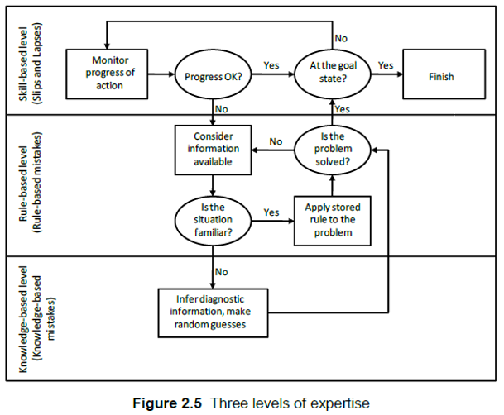
Benefits relating to senior citizens and their use of technology
  Improved chances of productive employment and
  Opportunities to use writing, e-mail and other computer tools.
  Seniors can share valuable experience and offer emotional support to others
  Communicate with children and family by e-mail or social media
Many designers adapt designs to cater for older adults because the world’s population ages and gets much older than in the past
Solutions
Desktop, web and mobile devices can be improved for all users by providing better control over font sizes, display contrast, and audio levels.
Keyboards easily reached, sufficient space between keys, provide audible or tactile feedback of pressed keys, and a high contrast between text and background
Mechanisms for supporting users with motor impairments
Improvements of interfaces used by senior citizens
  ▪ Easier-to-use pointing devices
  ▪ Clean navigation paths
  ▪ Consistent layouts
  ▪ A simpler command language
Expertise
The way in which a system is designed, built and sold depends on the intended users, on whether they are experts or novices. The model in figure 2.5 shows the differences between users with different degrees of information about an interactive system.

Slide 13
At the lowest level, the knowledge based level:
• May only be able to use general knowledge to help understand the system.
• Designers can exploit this to support novice users.
The second level of interaction
• Introduces the idea that users apply rules to guide their use of a system.
• This approach is slightly more informed than the use of general knowledge.
• Users will make inferences based on previous experience.
• Implies that designers should develop systems that are consistent.
• Users can apply the rules learned with one system to help them operate another
There are two forms of consistency:
• Internal consistency - similar operations being performed in a similar manner within an application.
• External consistency - similar operations being performed in a similar manner between several applications.
Over time, users will acquire expertise required to operate a system and will no longer need to think about previous experiences - the skill-based level
The Errors People Make Types of errors
Mistakes (incorrect plans)
  Forming wrong goal, performing wrong action with relation to a specific goal.
  Arise through lack of training, poor management or deliberate negligence
  Result of conscious but erroneous considerations of options.
  Occur when users don’t know what to do because they haven’t learned or haven’t been taught to use something properly
Slips
  Observable errors and result from automatic behaviour.
  Correct goal but performed the incorrect action
  Occur mostly in skilled behaviour; when user does not pay proper attention
  Users who are still learning don’t make slips
Norman distinguishes between the following kinds of slips:
Capture errors: Occurs when an activity that you perform frequently is done instead of the intended activity.
Description errors :Occurs when instead of the intended activity, you do something that has a lot in common with what you wanted to do.

Slide 14
Data-driven errors: Triggered by some kind of sensory input.
Mode errors: Occur when a device has different modes of operation and the same action has a different purpose in the different modes.
  ▪ Minimising different modes or making the different modes clearly visible, will avoid mode errors
Associative activation errors: Similar to description errors but are triggered by internal thoughts or associations instead of external data.
Loss-of-activation errors: Errors due to forgetting.
The cause of human error
▪ Poorly defined requirements / little testing - Bugs in the product can result in failure.
▪ Management failures - system may be well designed, but accidents can be caused by poorly trained operators.
▪ Poor working environments - system may work well in a development environment, but not with noise, heat, vibration
How to prevent human error
▪ There is no simple way to improve the operational safety of computer systems.
▪ Improving operator training won’t address fundamental problems created by mistakes & slips.
▪ Errors are latent within us, so we can never engineer out human error.
Steps that can reduce the frequency & cost of human error
  Engineer decision support systems that provide users with guidance during critical operations.
  Improve working practices (Introduce job monitoring and formal examinations).
When designing systems:
Keep in mind the kind of errors people make
Different modes be clearly visible - avoid modes errors
Interface request confirmation before deleting- Prevent deleting mistakes

Slide 15
Conclusion
Most computer-based systems are developed for use by people.
Different systems are aimed at different kinds of people.
It is crucial that whoever design these systems understand who they design for and how interacting with the system may affect these users
Human problems and errors with technology are often a design failure, and that good design always takes human capabilities and weaknesses in account.
Final conclusion: There is no such thing as the “average user”.
The end of chapter Two!!!

